Slide 1
Webservice versioning using osgi
Allard Buijze, Jettro Coenradie

Slide 2


Who is who
Allard Buijze
Jettro Coenradie
Allard.buijze@accenture.com
Jettro.coenradie@accenture.com
http://www.osgisamples.com

Slide 3
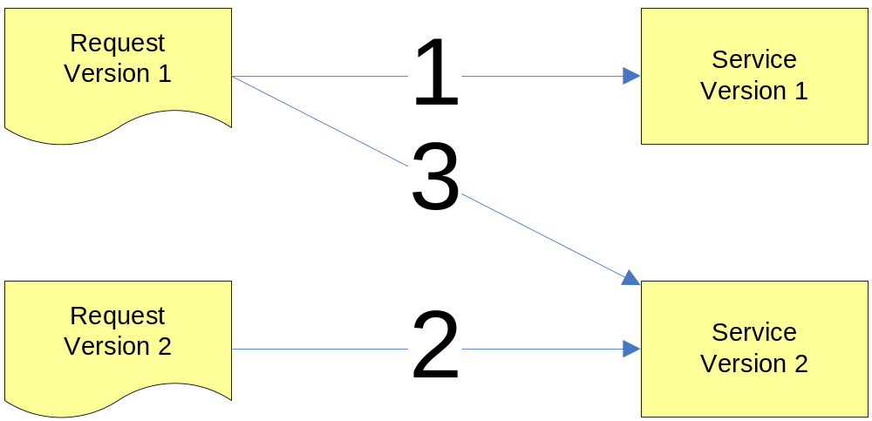
Demo of the problem
1 – OK
2 – FAILS
3 – OK

Slide 4

Agenda
Problem statement
Some well known solutions
About OSGi
Solution based on OSGi
Conclusion
Questions

Slide 5
Problem statement
Changing interfaces
Flexibility versus complexity
We do not have a solution to different versions of web services
that is flexible and has acceptable complexity.

Slide 6
Well known solutions
 | Flexibility | Complexity
Only the latest version | None | Very high
Multiple endpoints | Medium | Medium
Different namespaces | Medium | High
Multiple applications | High | Medium
Notes:
Only the last version
Flexibility
This the least flexible to consumers, a new version means an immediate upgrade, or to enhancements that need to be backwards compatible
Complexity
By supporting only the latest version, both service provider and all consumers will have to migrate simultaneously. This is organizationally very complex.
Multiple endpoints
Flexibility
With multiple endpoints you get higher flexibility, however the number of versions is limited to the required resources, the ear file can become very large. This can be used together with the last option ‘Multiple applications’
Complexity
It is possible to use multiple endoints, this means multiple ears, and therefore the implementation and deployment become more complex
Different namespaces
Flexibility
You can change the interace by using a different namespace, you do need to use this namespace in your package structure or you will get class loading problems. It is also not possible to use different versions of libraries for the different versions of your service.
Complexity
This can become very complex due to the maintenance effort. Many objects with the same name and a different package make errors very easily made.
Multiple applications
Flexibility
This solution is highly flexible, you can almost do anything you want. You can even take different versions of libraries
Complexity
This solutions is not very complex, most of the complexity has to do when bugs are found. You need to apply them to all versions. Also you need a lot of resources for all deployed ear files.

Slide 7

Introducing OSGi
It is not new
  The OSGi Alliance is founded in
  March 1999
  Latest release, OSGi R4 has a
  lot of momentum in the enterprise
A lightweight Service Oriented Architecture for components
OSGi is a specification of services provided by an implementation (e.g. Equinox, Felix, Knopflerfish)
Key to OSGi – Component based development

Slide 8
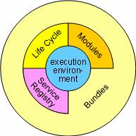
The specification
STANDARD SERVICES
On top of the Framework, the OSGi Alliance has specified many services. Services are specified by a Java interface. Bundles can implement this interface and register the service with the Service Registry. Clients of the service can find it in the registry, or react to it when it appears or disappears.
This is similar to the service-oriented architecture made popular with web services. The key difference between web services and OSGi services is that web services always require some transport layer, which makes it thousands times slower than OSGi services that use direct method invocations. Also, OSGi components can directly react on the appearance and disappearance of services.
The following sections give a short overview of the OSGi Release 4 services. More information can be found in the OSGi Service Platform Release 4 book or PDF download. Note that each service is defined abstractly and is independently implemented by different vendors.
FRAMEWORK SERVICES
The OSGi Framework provides a Permission Admin Service, a Package Admin Service and a Start Level Service. These services are (an optional) part and direct the operation of the Framework. Framework services are the following:
• (Conditional) Permission Admin – The permissions of current or future bundles can be manipulated through this service. Permissions are activated immediately once they are set.
• Package Admin – Bundles share packages with classes and resources. The update of bundles might require the system to re-calculate the dependencies. This Package Admin service provides information about the actual package sharing state of the system and can also refresh shared packages. I.e. break the dependencies and recalculate the dependencies.
• Start Level – Start Levels are a set of bundles that should run together or should be initialized before others are started. The Start Level Service sets the current start level, assigns a bundle to a start level and interrogates the current settings.
• URL Handler – The Java environment supports a provider model for URL handlers. However, this is a singleton making it impossible to use this in a collaborative environment like OSGi that potentially has many different providers. This service specification enables any component to provide additional URL handlers.
SYSTEM SERVICES
System Services provide horizontal functions that are necessary in virtually every system. The Log Service, Configuration Admin Service, Device Access Service, User Admin Service, IO Connector Service and Preferences Service are examples of system services.
• Log Service – The logging of information, warnings, debug information or errors is handled through the Log Service. It receives log entries and then dispatches these entries to other bundles that subscribed to this information.
• Configuration Admin Service – This service provides a flexible and dynamic model to set and get configuration information.
• Device Access Service – Device Access is the OSGi mechanism to match a driver to a new device and automatically download a bundle implementing this driver. This is used for Plug and Play scenarios.
• User Admin Service – This service uses a database with user information (private and public) for authentication and authorization purposes.
• IO Connector Service – The IO Connector Service implements the CDC/ CLDC javax. microedition.io package as a service. This service allows bundles to provide new and alternative protocol schemes.
• Preferences Service – This service provides access to hierarchical database of properties, similar to the Windows Registry or the Java Preferences class.
• Component Runtime – The dynamic nature of services -- they can come and go at any time -- makes writing software harder. The Component Runtime specification can simplify handling these dynamic aspects by providing an XML based declaration of the dependencies.
• Deployment Admin – The primary deployment format for OSGi is the bundle, which is a JAR/ZIP file. The Deployment Admin provides a secondary format: the deployment package. Deployment Packages can combine bundles with arbitrary resources into a single deliverable that can be installed and uninstalled. A comprehensive model of resource processors allows user code to extend the resource types.
• Event Admin – Many OSGi events have specific typed interfaces, making it hard to receive and filter events generically. The Event Admin provides such a generic, topic-based event mechanism. The specification includes mapping for all existing framework and service events.
• Application Admin – The OSGi bundle model is different from the typical desktop or mobile phone application model that relies on starting and stopping applications. The Application Admin prescribes such a traditional application model and its required management infrastructure.
PROTOCOL SERVICES
The OSGi Alliance has defined a number of services that map an external protocol to an OSGi service.
• Http Service – The Http Service is, among other things, a servlet runner. Bundles can provide servlets, which becomes available over the Http protocol. The dynamic update facility of the OSGi Service Platform makes the Http Service a very attractive web server that can be updated with new servlets, remotely if necessary, without requiring a restart.
• UPnP Service – Universal Plug and Play (UPnP) is an emerging standard for consumer electronics. The OSGi UPnP Service maps devices on a UPnP network to the Service Registry. Alternatively, it can map OSGi services to the UPnP network. This is a recommended Release 3 specification.
• DMT Admin – The Open Mobile Alliance (OMA) provides a comprehensive specification for mobile device management on the concept of a Device Management Tree (DMT). The DMT Admin service defines how this tree can be accessed and/or extended in an OSGi Service Platform.
MISCELLANEOUS SERVICES
• Wire Admin Service – Normally bundles establish the rules to find services that they want to work with. However, in many cases this should be a deployment decision. The Wire Admin service therefore connects different services together as defined in a configuration file. The Wire Admin service uses the concept of a Consumer and Producer service that interchange objects over a wire.
• XML Parser Service – The XML Parser service allows a bundle to locate a parser with desired properties and compatibility with JAXP.
• Initial Provisioning
• Foreign Application Access
Ubiquitous security
Standard services
Framework services
System services
Protocol services
Miscellaneous services

Slide 9
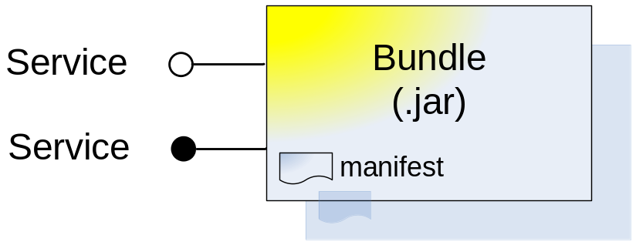
OSGi Concepts
Bundles and services
Exports, imports, dependencies
Versioning, class loading
Deployment of bundles
Notes:
A bundle is a deployable jar file, configured in a special fashion. The manifest file contains special headers to make OSGi recognize the jar as a bundle.
A single bundle may publish one or more interfaces as a service. These services can be turned on and off per bundle (not per service).
A bundle can also export packages. All classes in that package (but not in sub-packages) are available to other bundles that import that package. A bundle can also be dependant of (a specific version of) another bundle. All exported packages in the latter bundle are available in the aforementioned one.

Slide 10
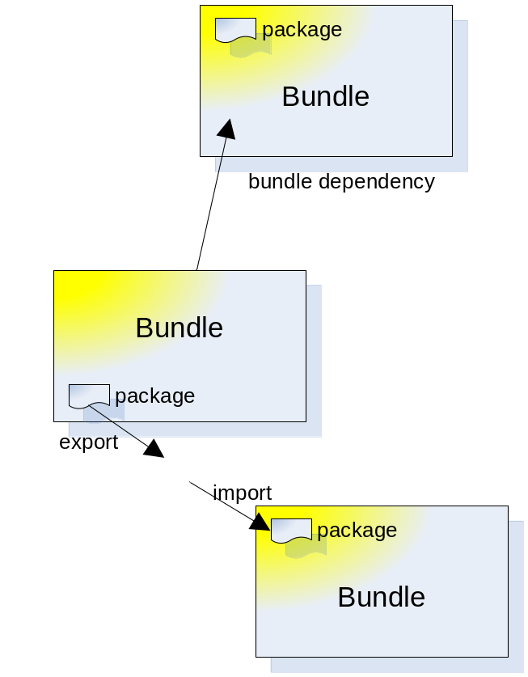
OSGi Concepts
Bundles and services
Exports, imports, dependencies
Versioning, class loading
Deployment of bundles
Notes:
A bundle is a deployable jar file, configured in a special fashion. The manifest file contains special headers to make OSGi recognize the jar as a bundle.
A single bundle may publish one or more interfaces as a service. These services can be turned on and off per bundle (not per service).
A bundle can also export packages. All classes in that package (but not in sub-packages) are available to other bundles that import that package. A bundle can also be dependant of (a specific version of) another bundle. All exported packages in the latter bundle are available in the aforementioned one.

Slide 11
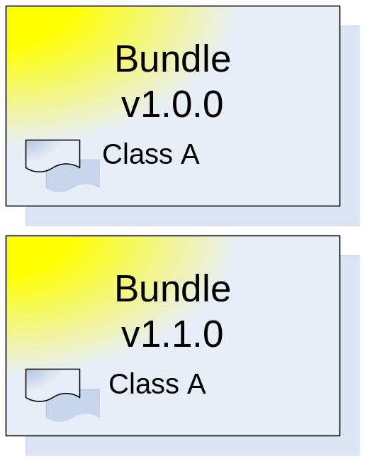
OSGi Concepts
Bundles and services
Exports, imports, dependencies
Versioning, class loading
Deployment of bundles
Notes:
A bundle is a deployable jar file, configured in a special fashion. The manifest file contains special headers to make OSGi recognize the jar as a bundle.
A single bundle may publish one or more interfaces as a service. These services can be turned on and off per bundle (not per service).
A bundle can also export packages. All classes in that package (but not in sub-packages) are available to other bundles that import that package. A bundle can also be dependant of (a specific version of) another bundle. All exported packages in the latter bundle are available in the aforementioned one.

Slide 12
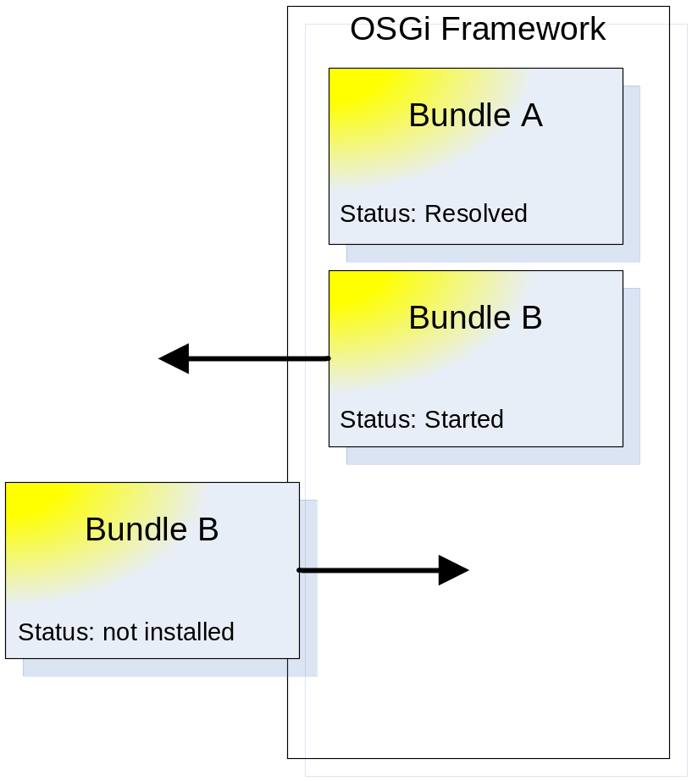
OSGi Concepts
Bundles and services
Exports, imports, dependencies
Versioning, class loading
Deployment of bundles
Notes:
A bundle is a deployable jar file, configured in a special fashion. The manifest file contains special headers to make OSGi recognize the jar as a bundle.
A single bundle may publish one or more interfaces as a service. These services can be turned on and off per bundle (not per service).
A bundle can also export packages. All classes in that package (but not in sub-packages) are available to other bundles that import that package. A bundle can also be dependant of (a specific version of) another bundle. All exported packages in the latter bundle are available in the aforementioned one.

Slide 13



Proposed solution based on OSGi
Tools
Eclipse (development + debugging)
Equinox
Servlet bridge (production)
AXIS, JAXB
Jetty
Google Web Toolkit

Slide 14
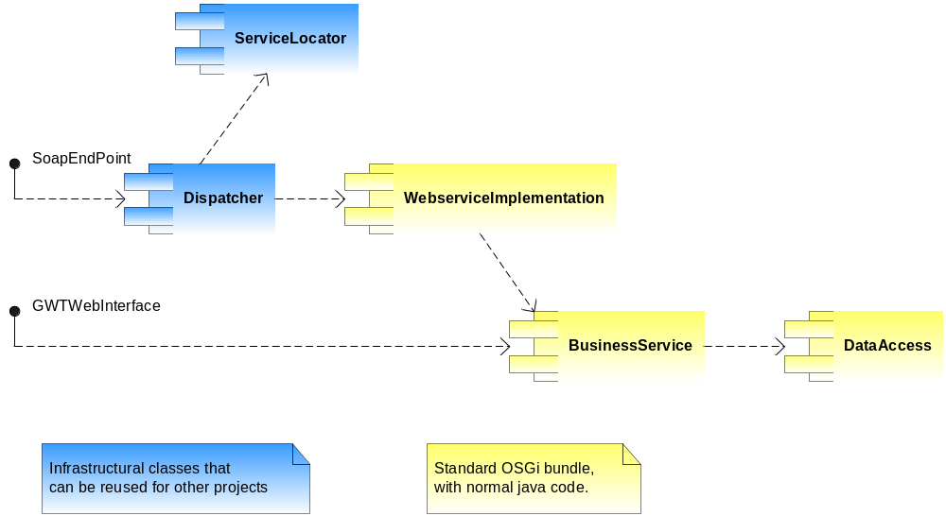
Solution architecture

Slide 15
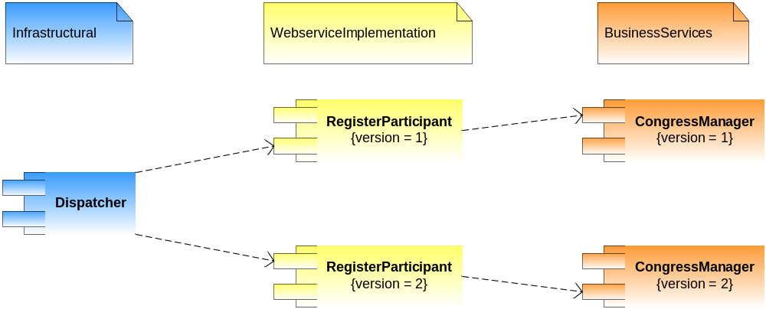
Solution architecture
X

Slide 16
Refreshing webservices technology
WSDL – used by client to:
Identify contents of request and response message
Find location of the endpoint
Serialization/Deserialiation
Parsing of xml to objects and back again
Notes:
Remember to explain the location of (de)serialization using jaxb. Not in the dispatcher but in the service implementations.
Explain why we need the xsd within the bundle and the concept of generating the wsdl.

Slide 17
The Case:
Congress Registration
Use case version 1:
Register participant for congress
Use case version 2:
Register participant for congress with sessions
New participants are created and registered
Participants are identified by email address

Slide 18
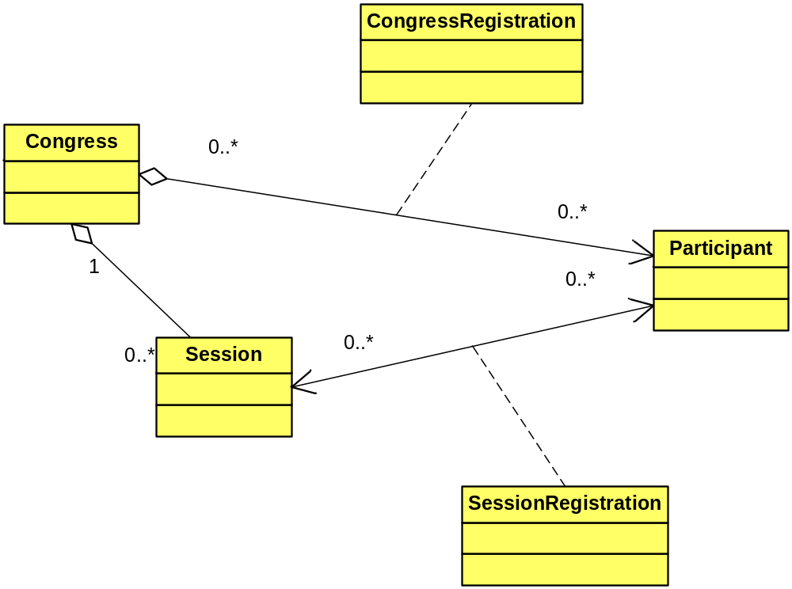
The Case:
Congress Registration
Notes:
Beware that this is a simplification of the real model

Slide 19
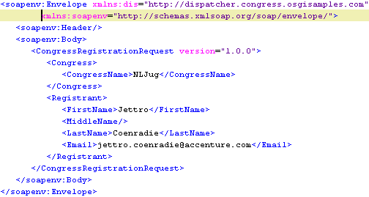
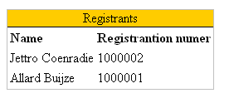
Demo
Show the web service and the web project
Show different versions of bundles
Notes:
Eclipse new project wizard creating a eclipse plugin which is in fact a osgi bundle
Manifest editor
Dispatcher
Locator inclusive the ServiceTracker (explain the importance of the interface implemented by all webservice providers)
Activator of the Webservice implementations
WebServiceImpl

Slide 20
Well known solutions
UPDATED
 | Flexibility | Complexity
Only the latest version | None | Very high
Multiple endpoints | Medium | Medium
Different namespaces | High | High
Multiple applications | High | Medium
OSGi based versioning
Very High
Medium
Notes:
By supporting only the latest version, both service provider and all consumers will have to migrate simultaneously. This is organizationally very complex.

Slide 21
Conclusions
OSGi enforces Component Based Development
Web service versioning is possible with OSGi and a few small components
OSGi increases the flexibility, without increasing complexity
Eclipse and Equinox are a good combination in developing OSGi based applications

Slide 22
More …
Read more and download the sample source code on http://www.osgisamples.com
Sign up and contribute !

Slide 23

Visit the Accenture Technology Solutions stand

